Slide 1
Digital Portfolio
STUDENT NAME: Dhinakaran M
REGISTER NO AND NMID: asunm1112401111058012
DEPARTMENT: computer science
COLLEGE: L.N. Government college, Madras University.

Slide 2
PROJECT TITLE
Digital portfolio using front end web development

Slide 3


AGENDA
Problem Statement
Project Overview
End Users
Tools and Technologies
Portfolio design and Layout
Features and Functionality
Results and Screenshots
Conclusion
Github Link
3/21/2024 Annual Review

Slide 4

PROBLEM STATEMENT
In today's digital era, traditional resumes aren't enough.They don't showcase skills and projects effectively.Many students and professionals lack a structured online presence.A digital portfolio provides an interactive platform.It helps present achievements, skills, and experiences.This is useful for showcasing work in a digital age.Digital portfolios are accessible and interactive.They highlight work in a more engaging way than resumes.This addresses the limitations of traditional resumes.It benefits students and professionals seeking to showcase work.

Slide 5

PROJECT OVERVIEW
Portfolio contains sections: About Me, Projects, Skills, Contact.
Main idea: Showcase personal achievements, skills, and projects.
Cartoon pencil character on the right side.
3. Background has blue and white design elements.
4.Timestamp shown: 11:01, 21-08-2025.
5.Taskbar at bottom with various app icons.
6.Page has navigation controls (left arrow, circle, three lines).
7.Overall design is clean with a playful touch (cartoon pencil).

Slide 6

WHO ARE THE END USERS?
The web page serves as a digital portfolio to showcase personal skills, projects, and experiences.
It provides a modern alternative to resumes, helping users present their work more effectively.
The site includes sections like Home, About, Projects, and Contact for easy navigation.
A responsive design ensures accessibility across devices, including mobiles and tablets.
Interactive elements like a project showcase and contact form improve engagement.
The platform benefits students, job seekers, freelancers, and professionals alike.
Overall, it enhances visibility, credibility, and personal branding in the digital space.

Slide 7

TOOLS AND TECHNIQUES
The portfolio web page is built using HTML to define the structure with sections like Home, About, Projects, and Contact.
CSS is applied for styling, ensuring appealing colors, layouts, and responsive design across devices.
JavaScript adds interactivity through features like a navigation menu toggle, animations, and form validation.
The design follows a user-friendly layout to make information easily accessible.
It serves as a personal portfolio to display skills, projects, and achievements.
Development was carried out using VS Code/CODEPEN for efficient coding and testing.
The project can be hosted on GitHub Pages, making it easily shareable and accessible online

Slide 8
POTFOLIO DESIGN AND LAYOUT
The portfolio web page includes a Home section that introduces the user.
An About Me section provides details about background and interests.
The Projects section highlights key works and achievements.
A Skills section showcases technical abilities and expertise.
The Contact section allows visitors to connect directly.
The design ensures a responsive layout, working smoothly on both desktop and mobile devices.
Overall, the site serves as a professional digital portfolio for showcasing personal and technical strengths.
8

Slide 9
FEATURES AND FUNCTIONALITY
This project is a personal portfolio website built to highlight achievements and skills.
It provides a modern alternative to resumes by offering an interactive platform.
The Home section introduces the user with a clear first impression.
The About Me section shares personal details, interests, and background.
The Projects and Skills sections showcase key works, technical expertise, and abilities.
The Contact section enables easy communication with visitors and recruiters.
Overall, the portfolio serves as a professional showcase for personal branding and career growth.

Slide 10
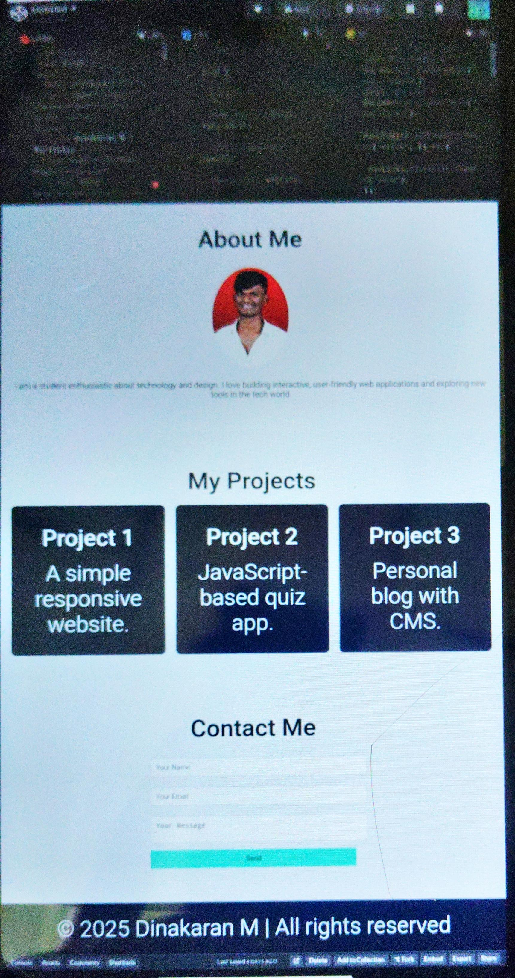
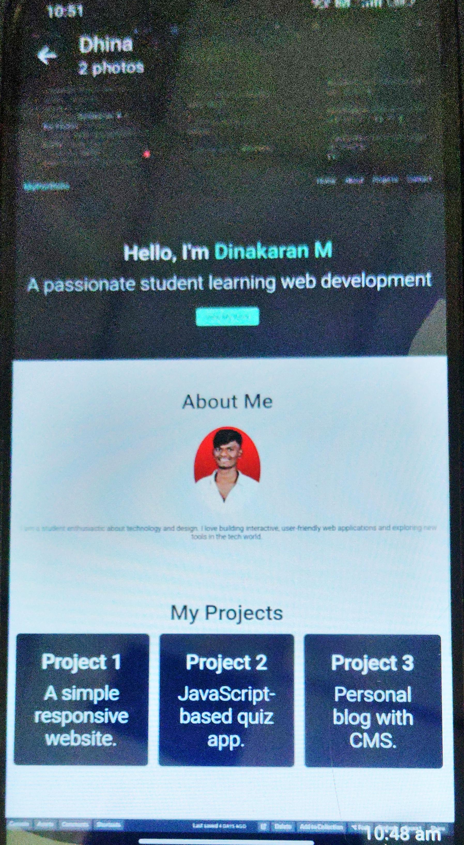

RESULTS AND SCREENSHOTS
3/21/2024 Annual Review
10

Slide 11
CONCLUSION
This project successfully delivers a responsive digital portfolio website.
It highlights personal achievements, skills, and projects in an organized manner.
The site offers a modern and interactive alternative to traditional resumes.
Its user-friendly layout ensures smooth navigation across devices.
Features like the Projects showcase and Contact form enhance engagement.
The platform helps students, job seekers, and professionals present themselves effectively.
Overall, it contributes to society by improving career opportunities and personal branding in the digital age.
11

Slide 12
Digital portfolio
https://dhina2006karan.github.io/TNSDC-FWD-DP/

